Slide 1
Jacksonville’s Rowing Center Opportunities

Slide 2
Why Rowing?
Unique race position: Southernmost Head Race (extends season in fall); possible spring opportunity
Arlington River- University and Cesery bridges offer viewing opportunity as does Exchange Island
Great scholarship potential for students
Health and exercise benefits

Slide 3
SPRINT RACES VS. HEAD RACES
HEAD RACES
Head races are run over a course an average distance of 3 miles. Instead of being a distance race, it’s raced against the clock, with the goal being to have the fastest overall time with as few penalties as possible. Crews are started 10-15 seconds apart, allowing for faster crews to overtake slower ones along the course.
SPRINT RACES
Rowers cover a course of 2000m whereas in most high school races, rowers cover 1500m. Anywhere from 4-8 boats are lined up at the starting line

Slide 4
The Location

Slide 7
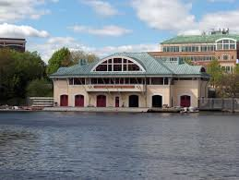
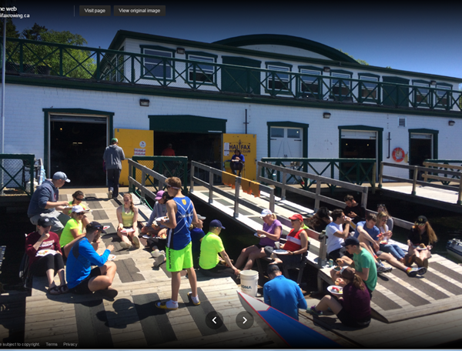
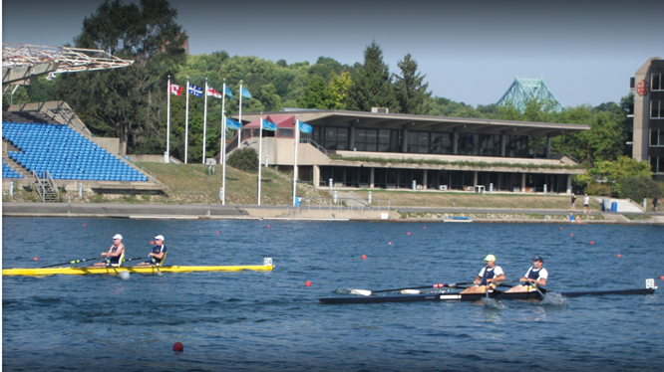
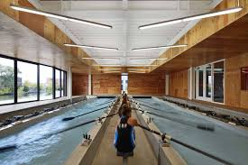
Boathouse Facilities

